Slide 1
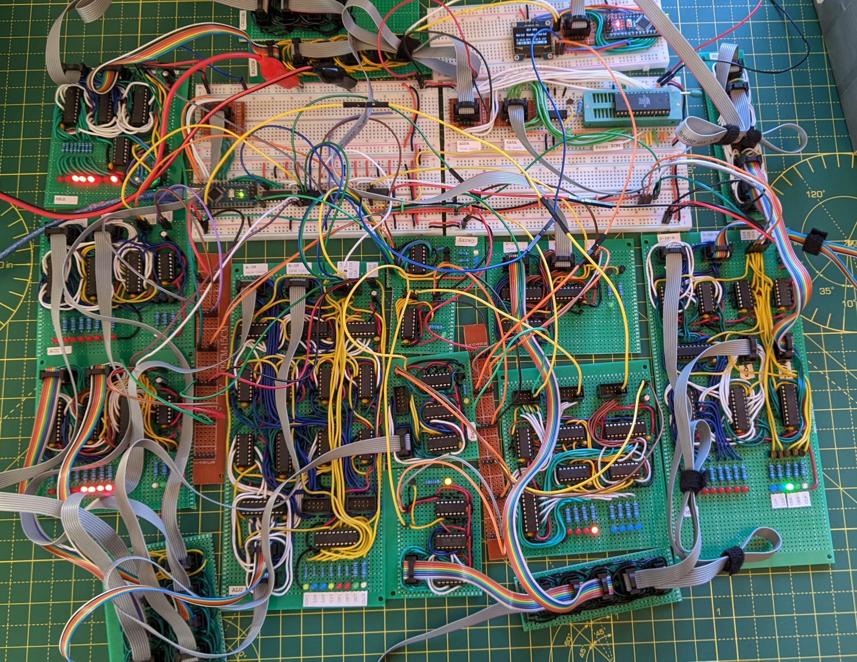
CADDR
Memory Mapped Output
XADDR
Control Unit
MAR
XDATA
Program ROM
Accumulator
Carry
X Register
Bus Bridge
Z Selection
Zero (ALU)
P Register
CDATA
Zero (CDATA)
MBR
ALU
CDATA

